Slide 1
Avionics for recovery system
TEAM CURIOSITY

Slide 2
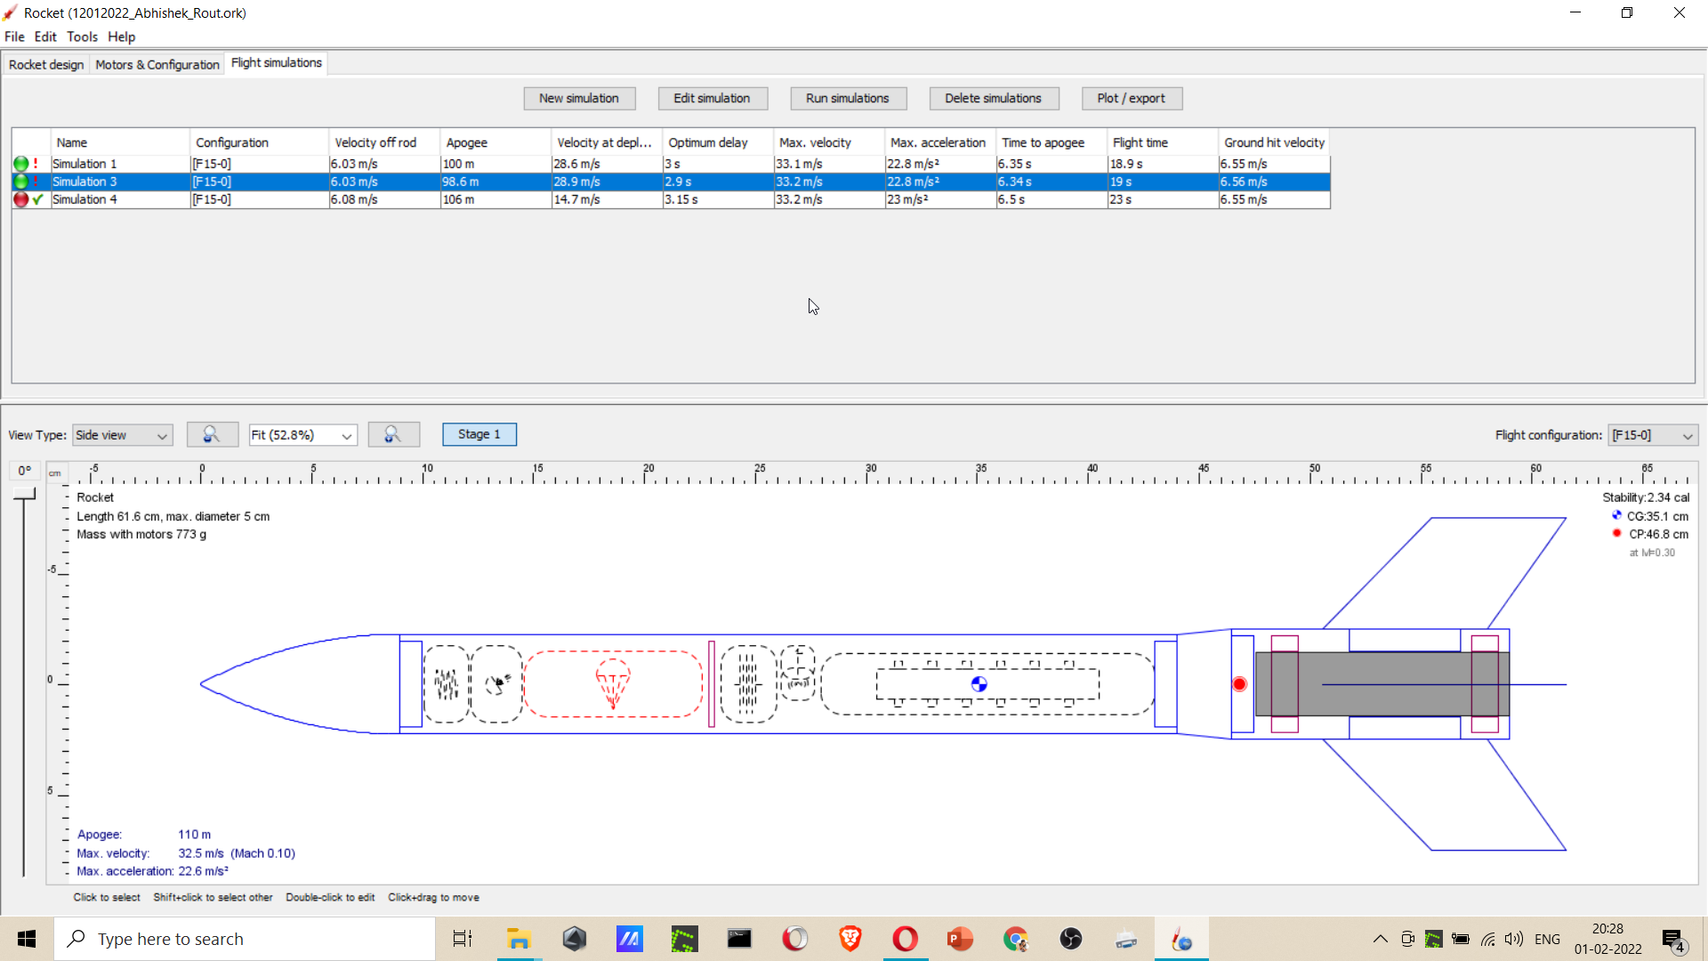
What to measure?

Slide 3
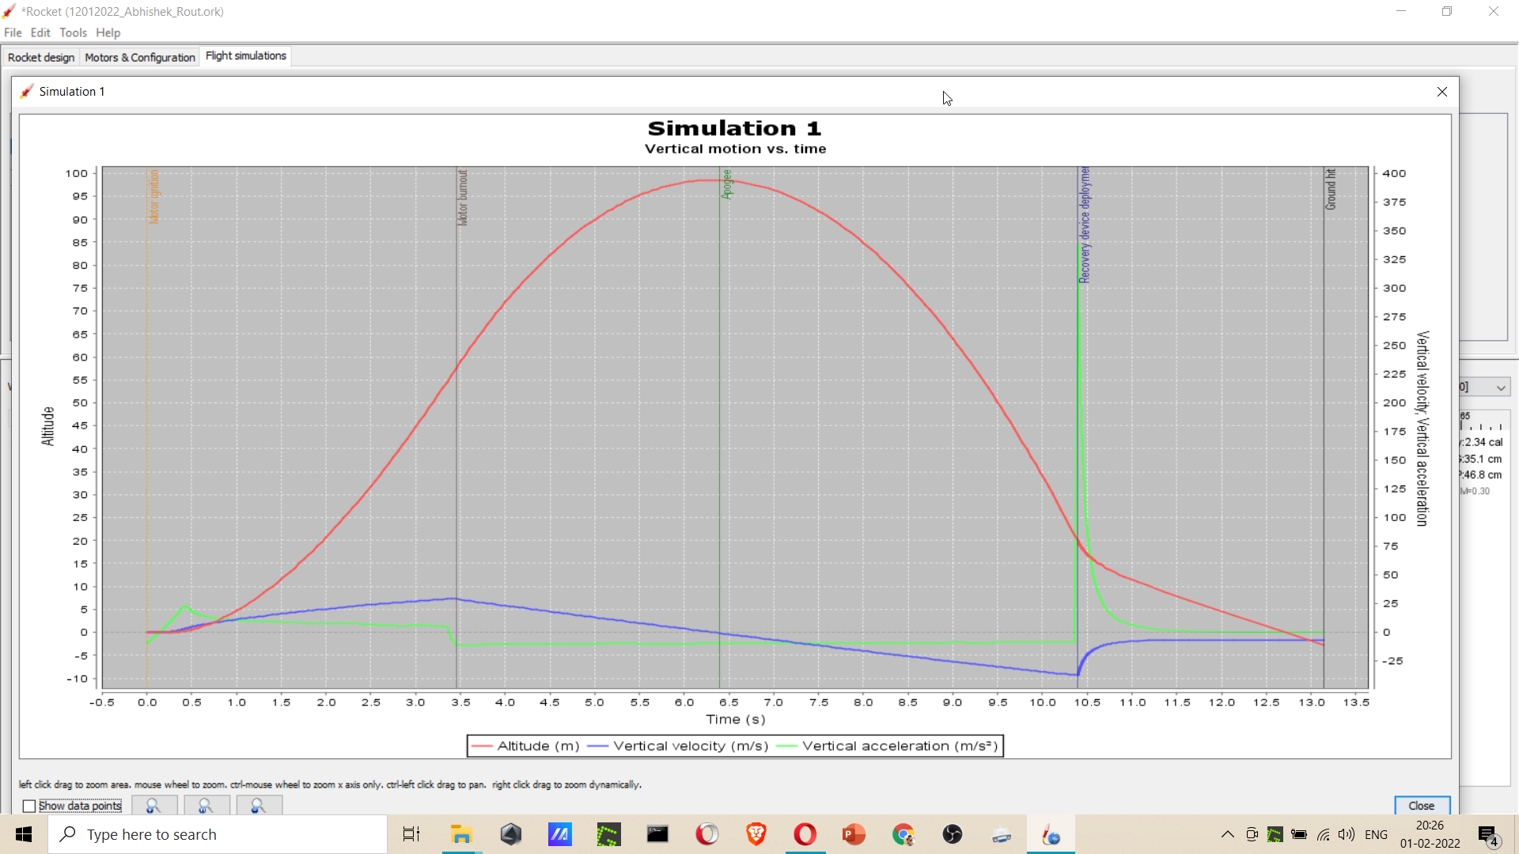

Slide 4
What to measure?
Apogee (Altitude)
Time of flight to apogee as well as total time of flight
Vertical acceleration
Vertical velocity
Ground hit velocity from vertical velocity i.e. from accelerometer
Temperature humidity of the atmosphere after ejection of parachute

Slide 5
Avionics component to be used
Arduino Nano
Battery
Servo
Accelerometer(ADLX335)
Gyroscope if required
Altimeter (pressure meter)
SD card to store data
Temperature humidity sensor
LED indicator for test control
NodeMcu- if ground level test of sensors required before liftup
MPU-6050..

Slide 6
Non Pyro ejection system
Altitude decrease…then eject
Vertical acceleration…-ve
AND statement…of 1 &2
2 sec after time to apogee considered
CAN use 2 systems if one fails to eject then other works
- altitude decrease if value of altitude less than previous one
- 2 or 3 sec after the considered time to apogee in open rocket
- if z value changes from +ve to -ve

Slide 7
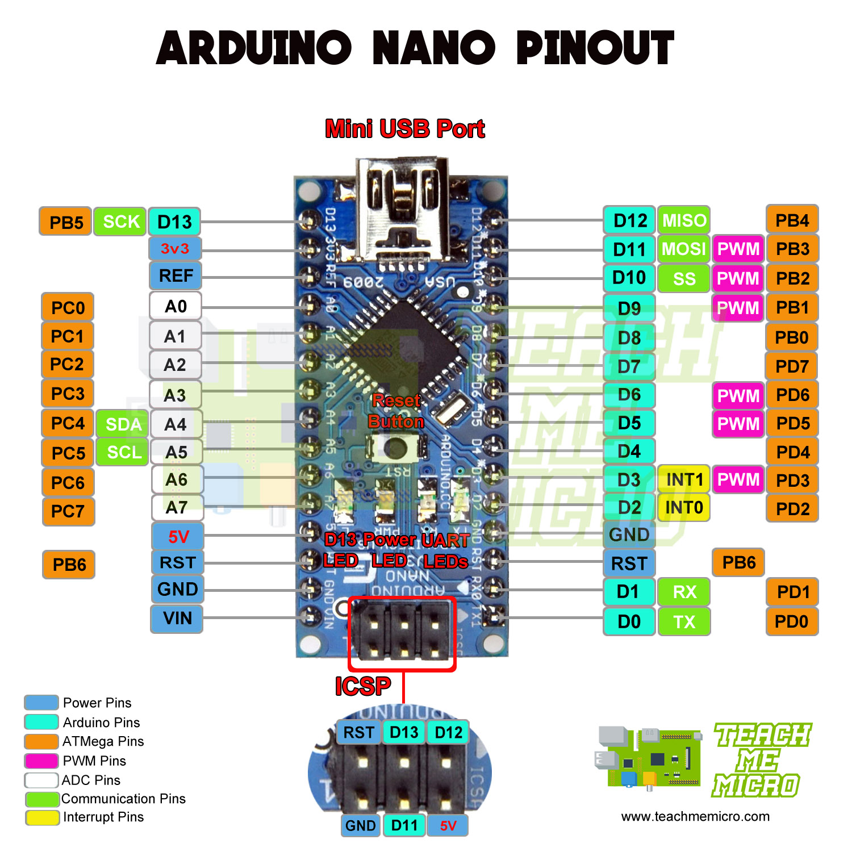
Nano pin diagram

